Slide 1
natl_gaps_no_action
1 US WTIV starting with CVOW

Slide 2
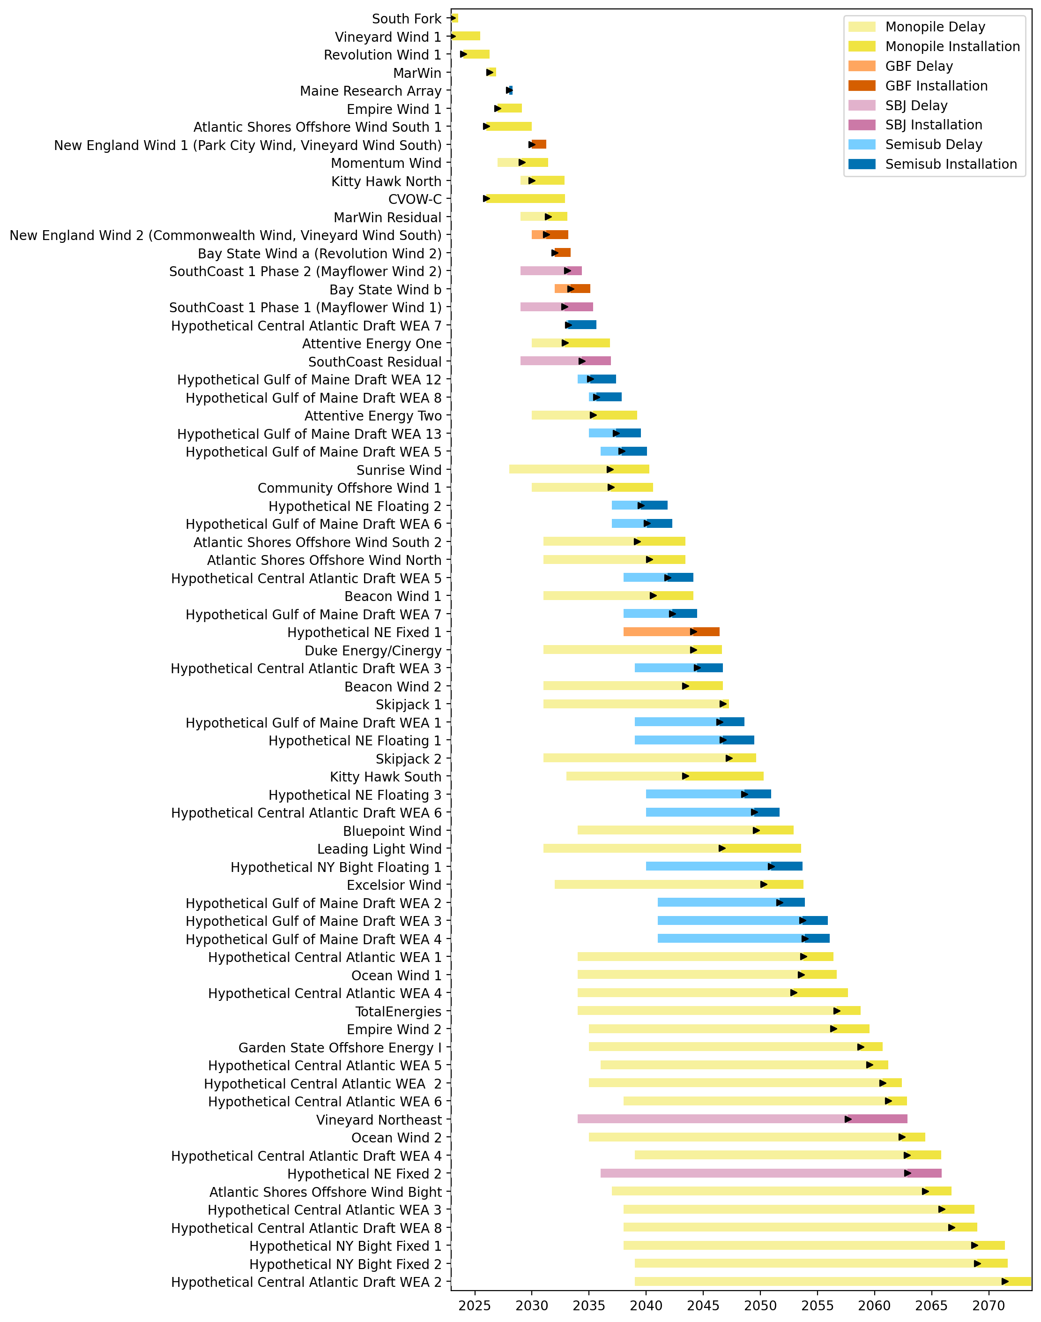
Full Gantt

Slide 3
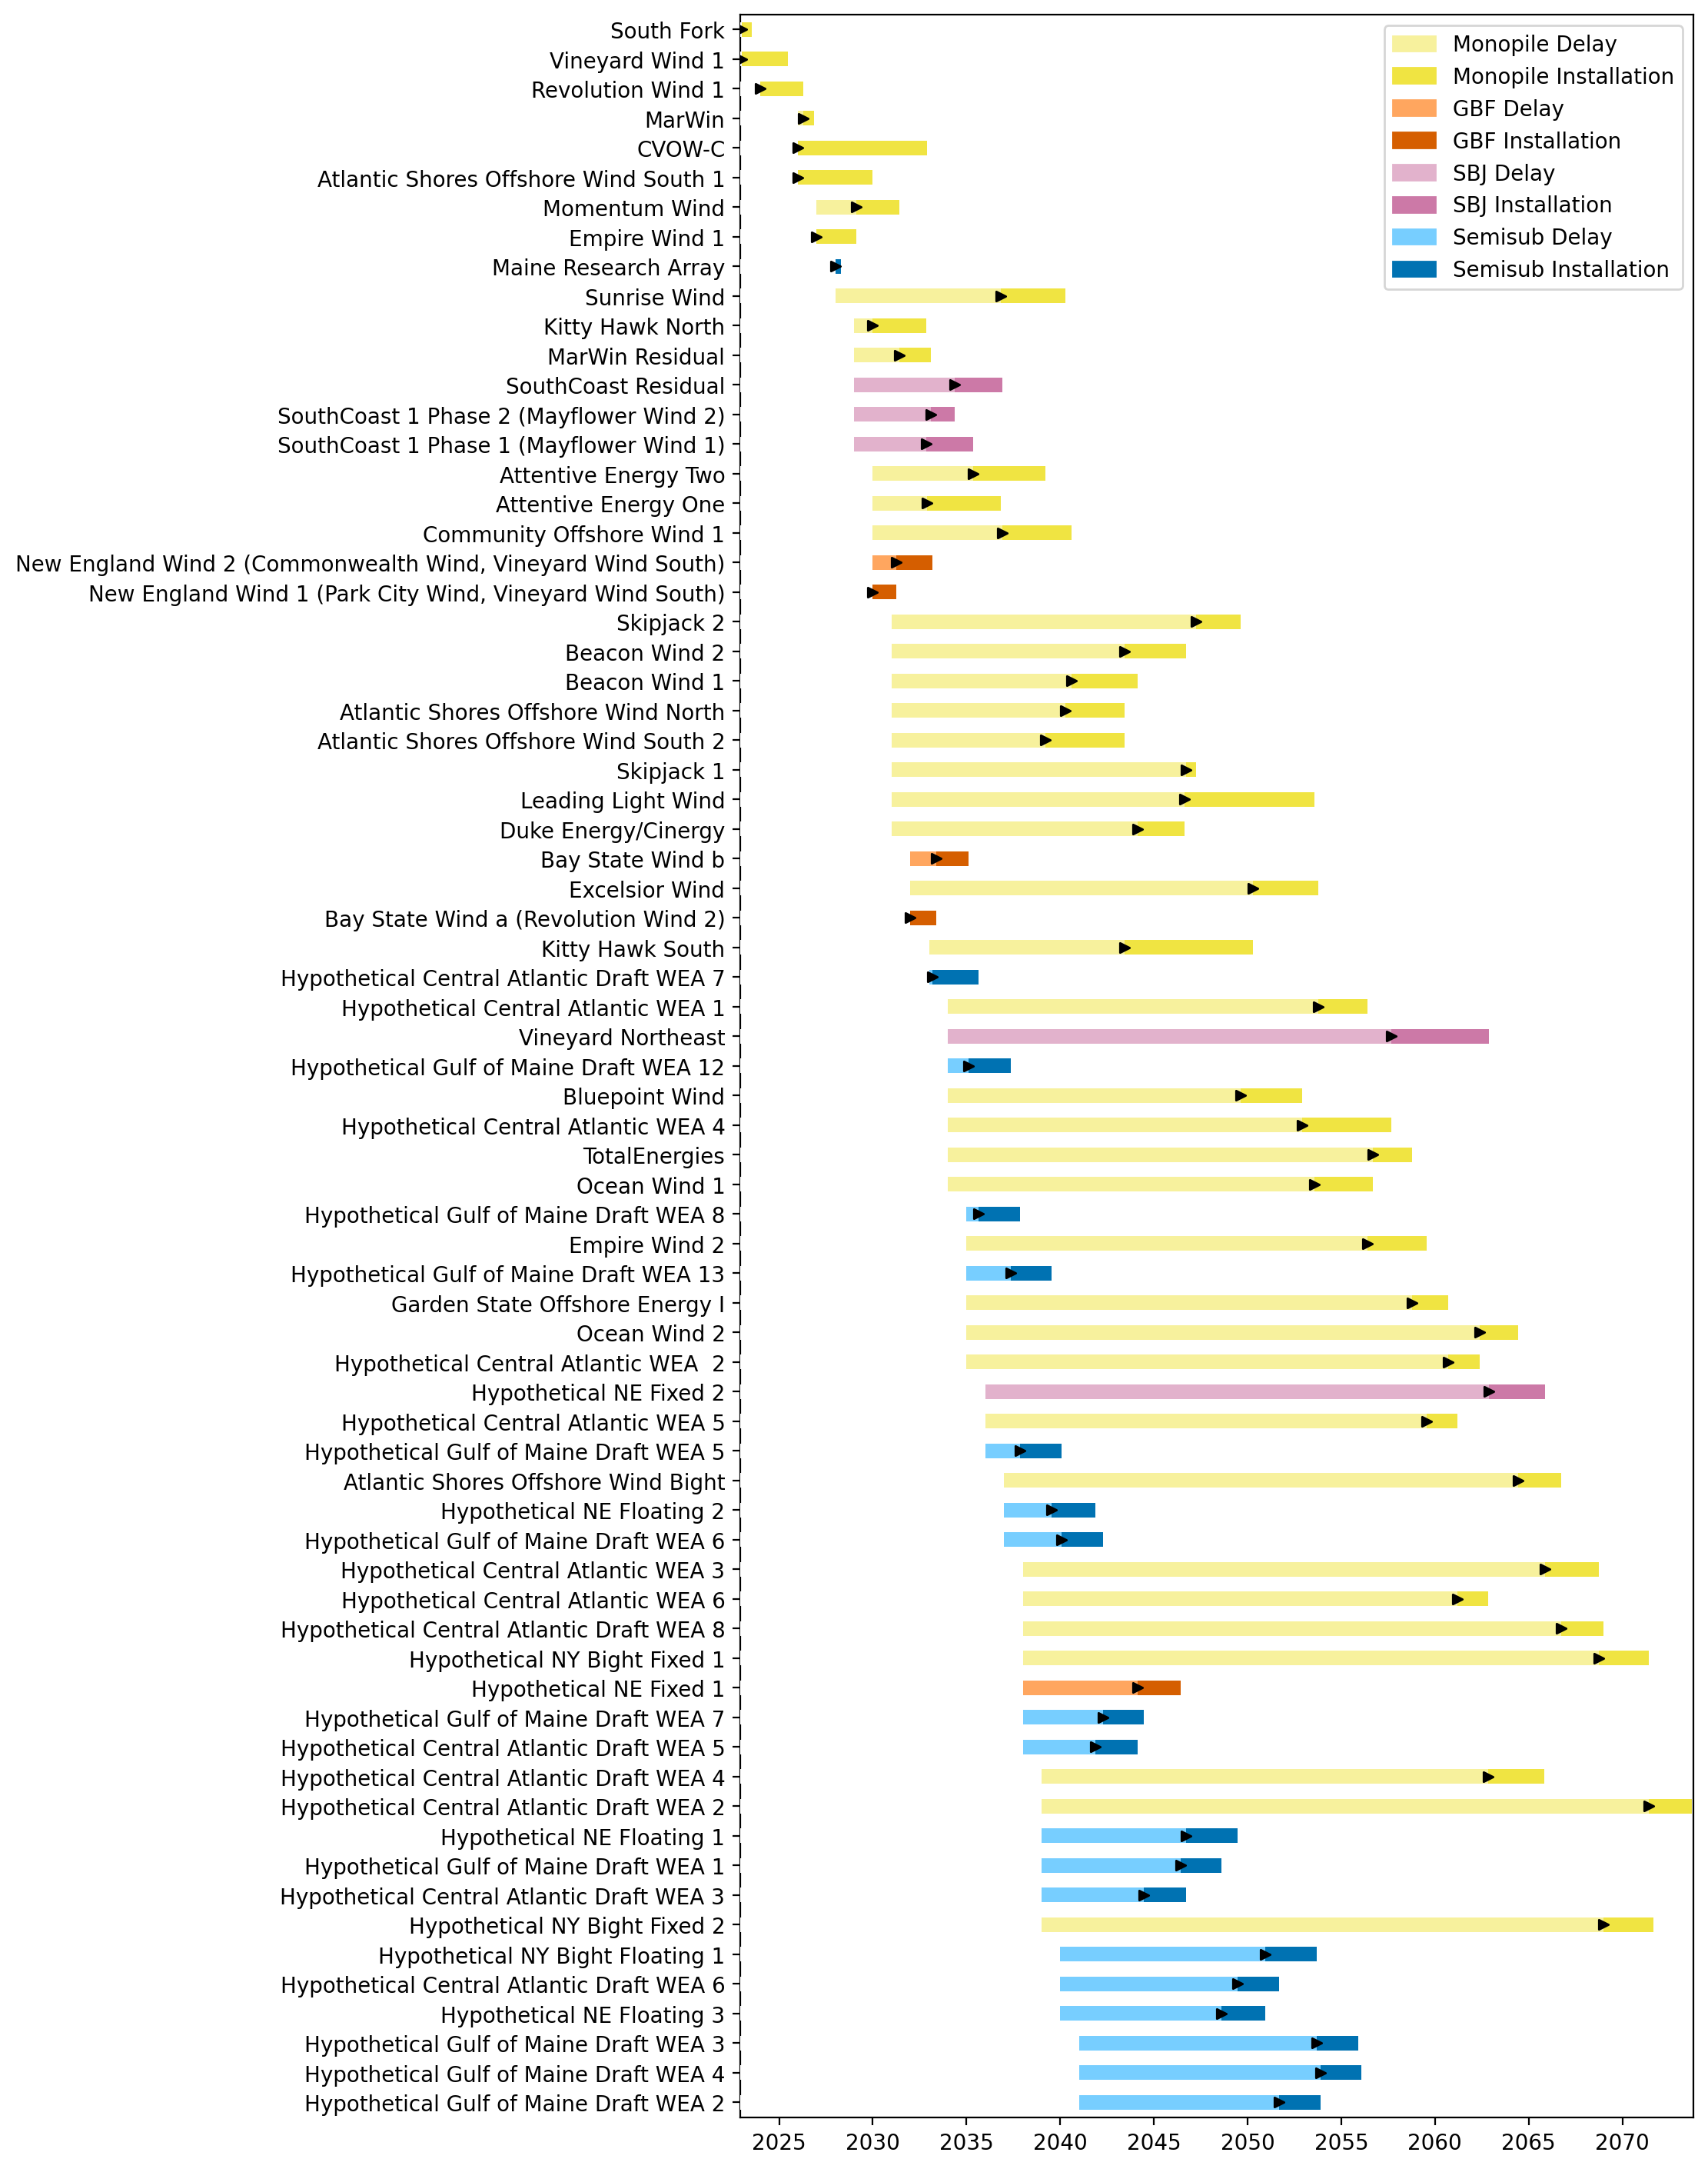
Sorted Full Gantt

Slide 4
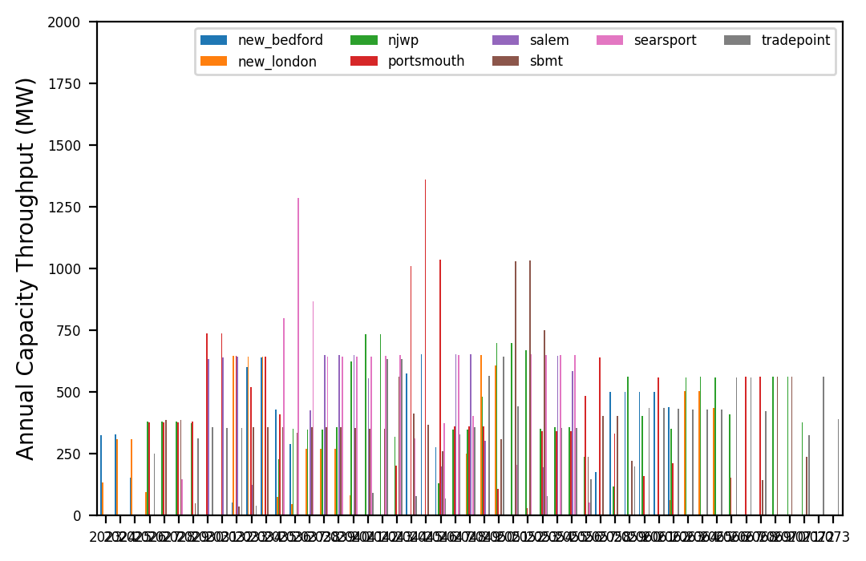
Port Throughput

Slide 5
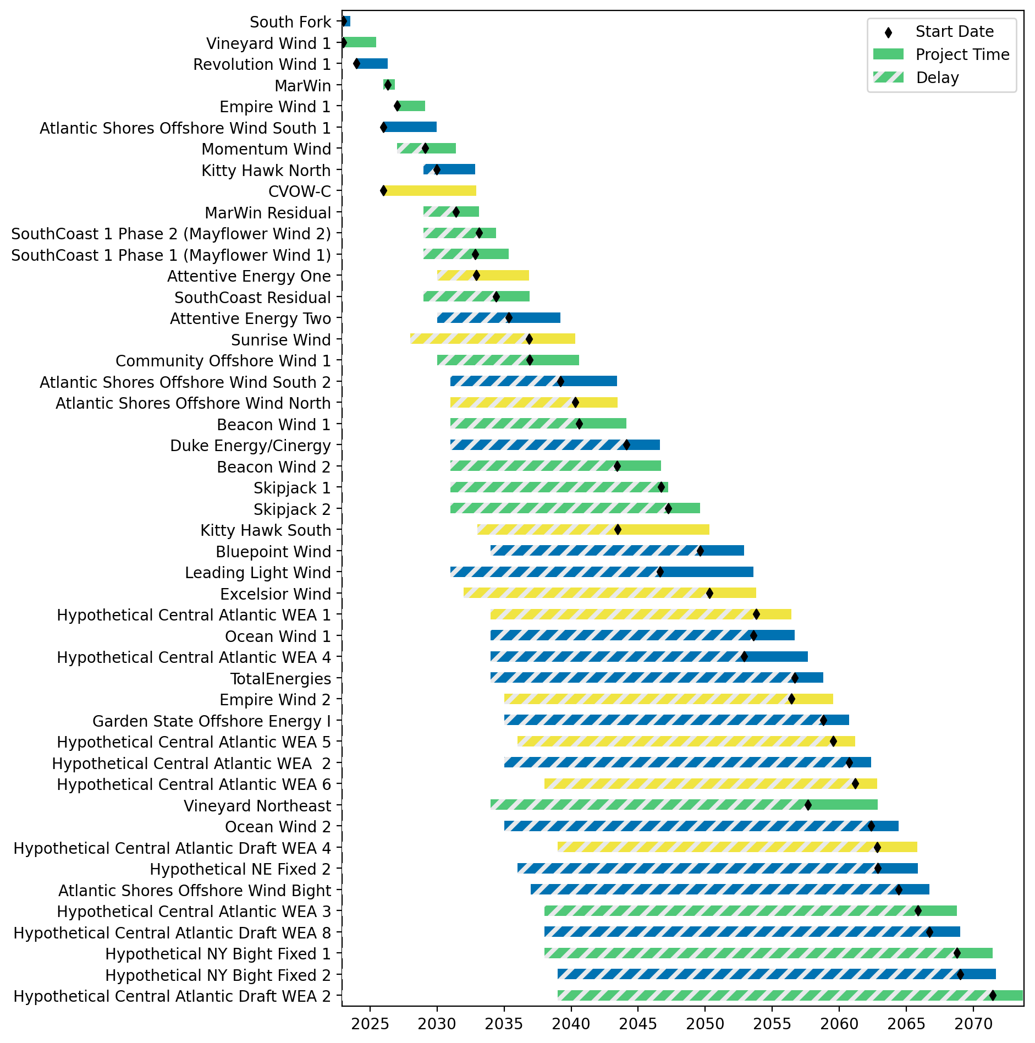
Fixed Gantt

Slide 6
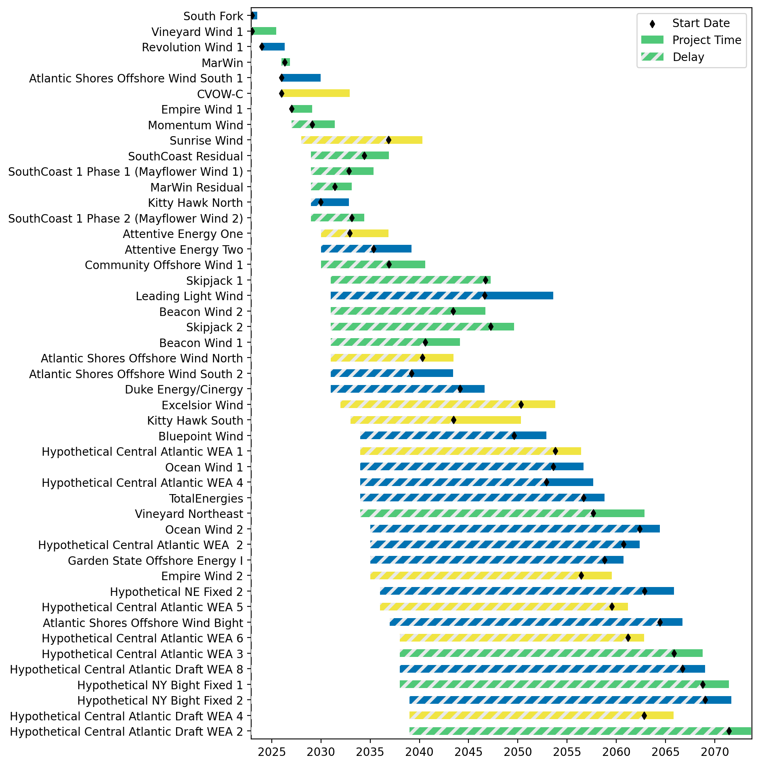
Sorted Fixed Gantt

Slide 7
natl_gaps_3foreign
1 more foreign WTIV 2025

Slide 8
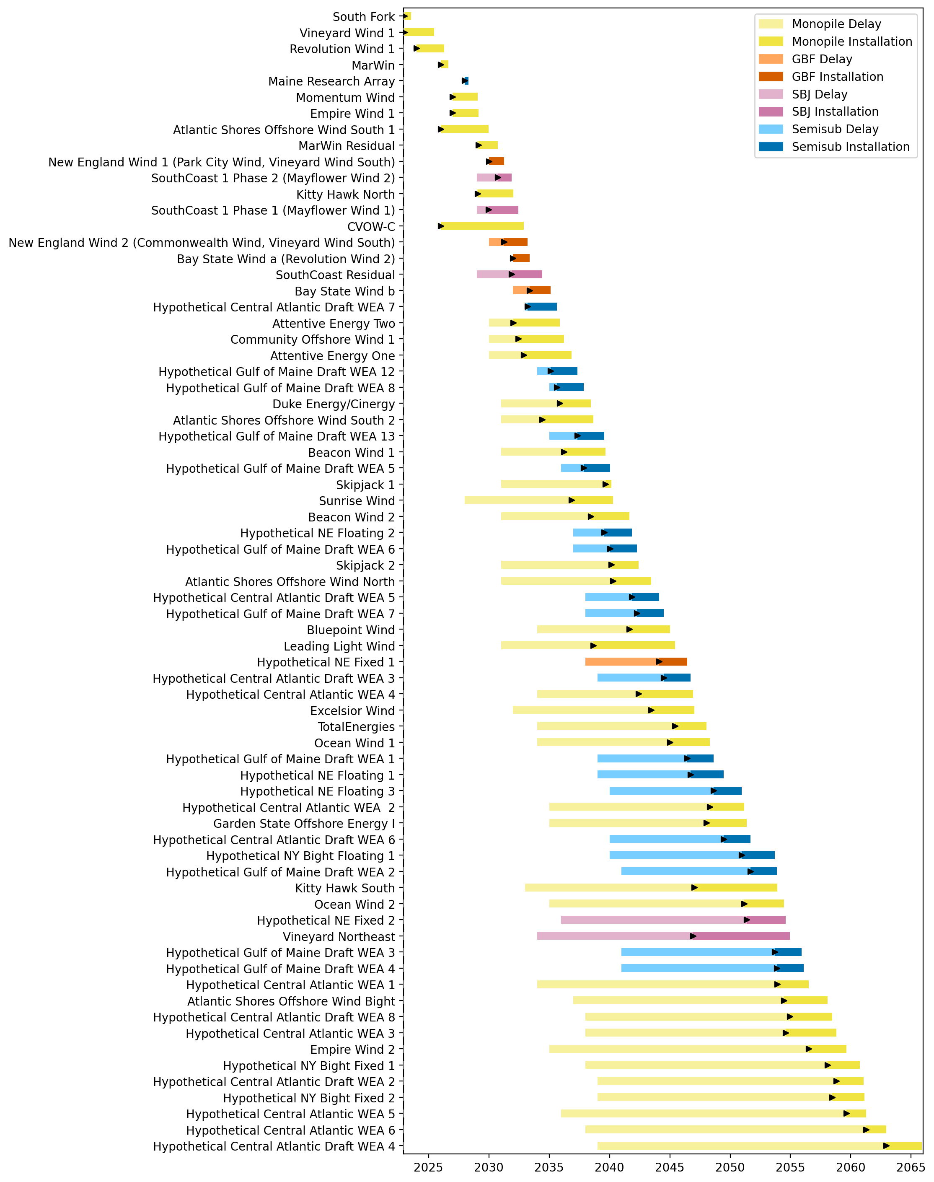
Full Gantt

Slide 9
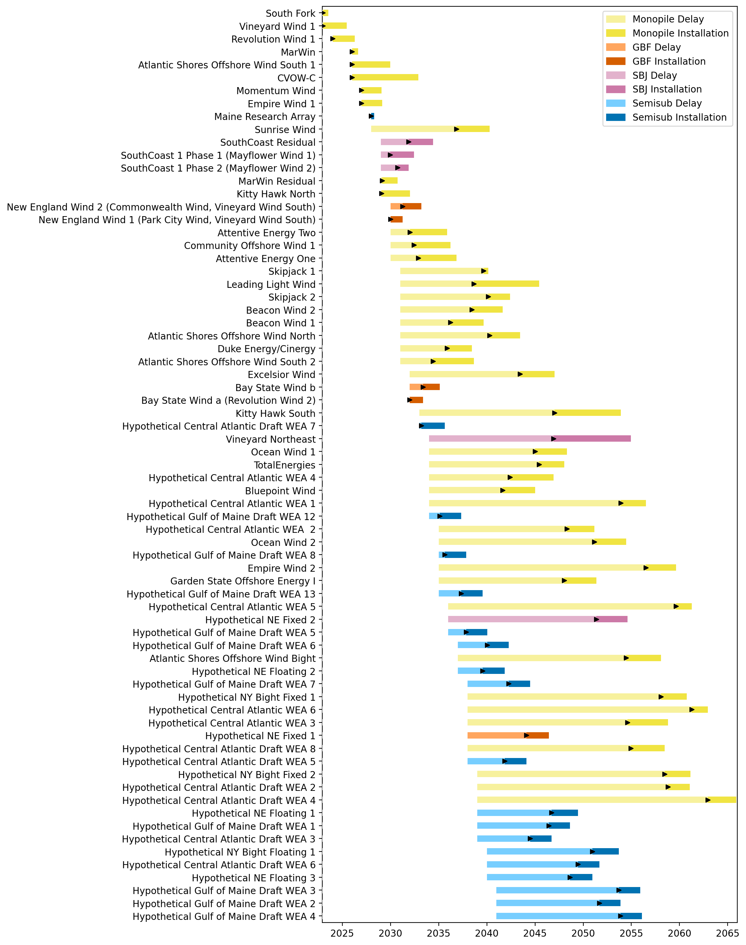
Sorted Full Gantt

Slide 10
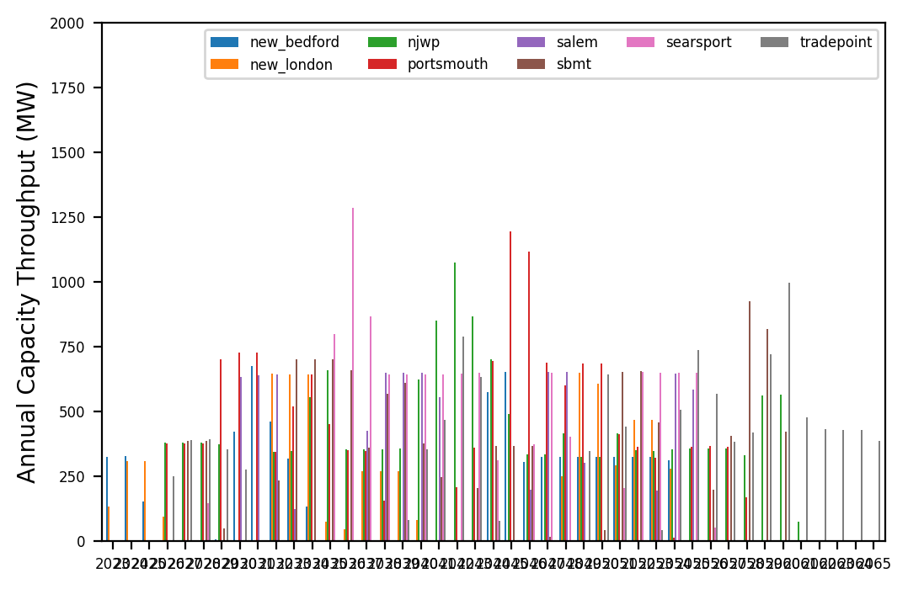
Port Throughput

Slide 11
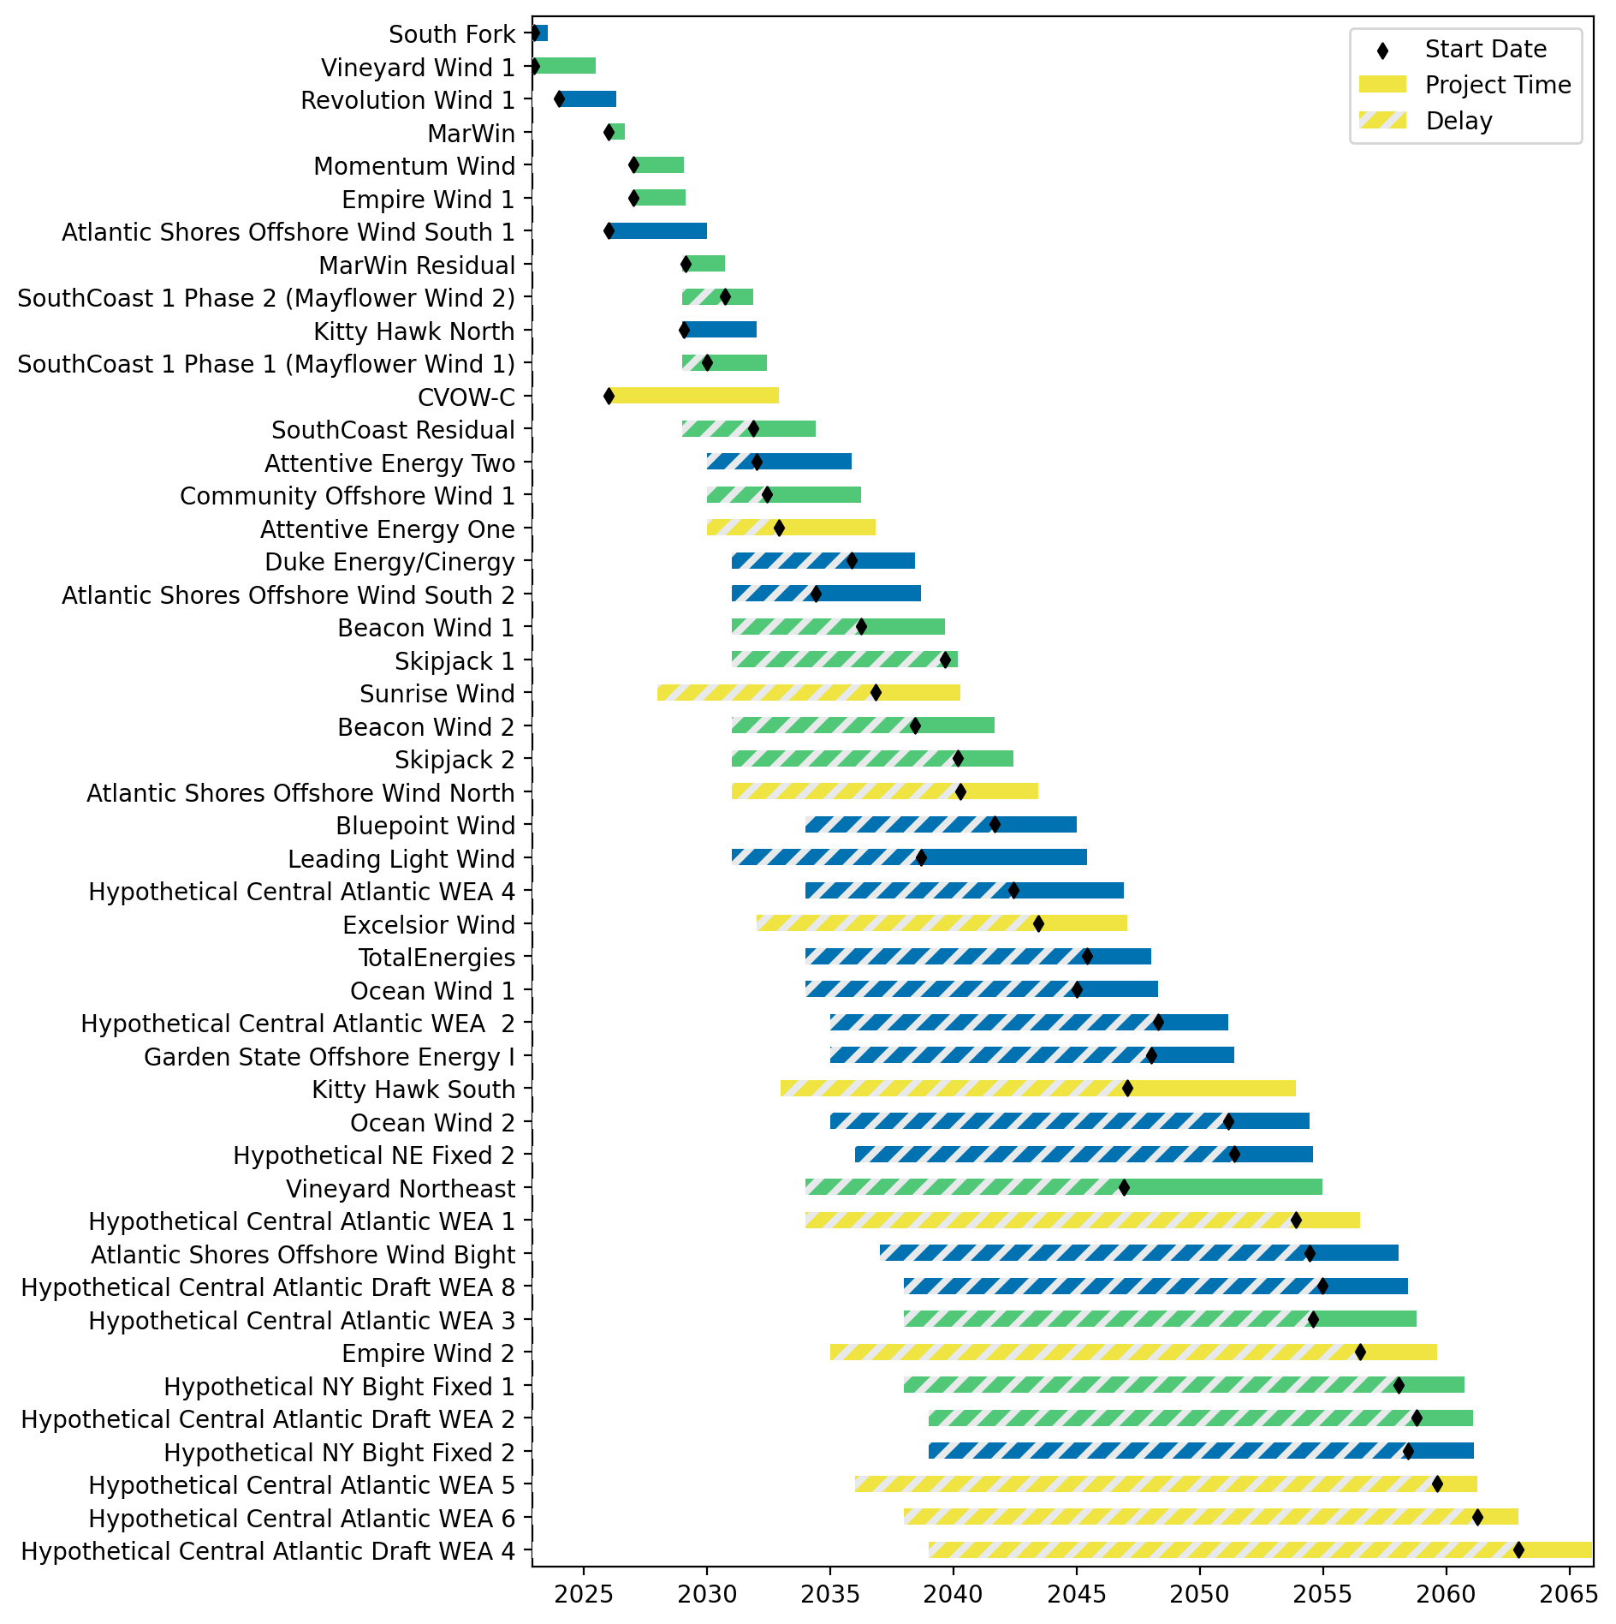
Fixed Gantt

Slide 12
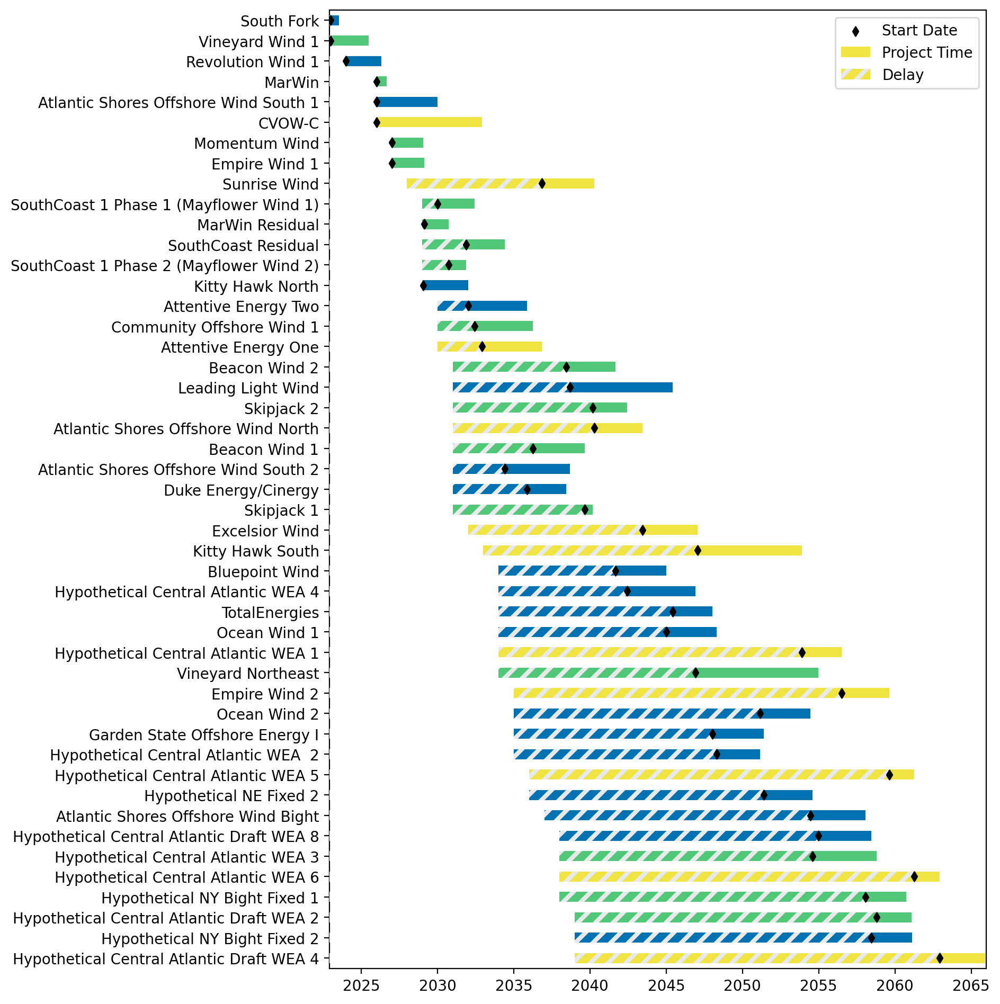
Sorted Fixed Gantt

Slide 13
natl_gaps_4foreign
1 more foreign WTIV 2025

Slide 14
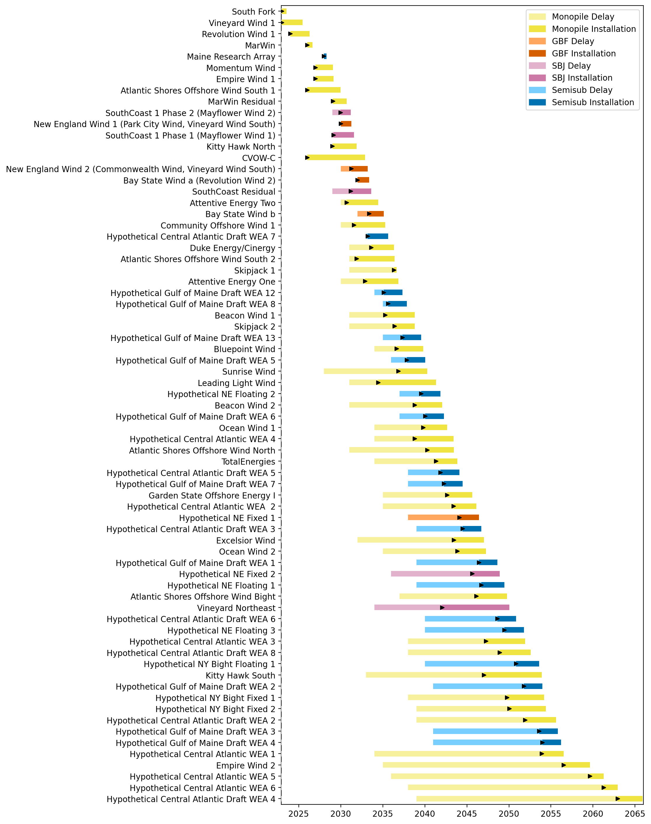
Full Gantt

Slide 15
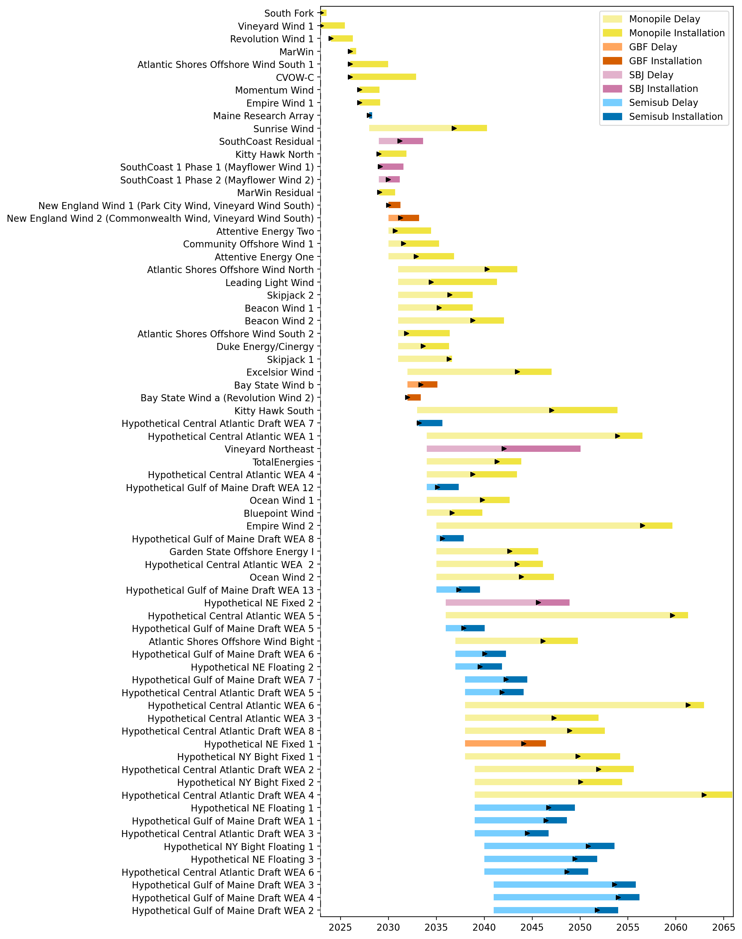
Sorted Full Gantt

Slide 16
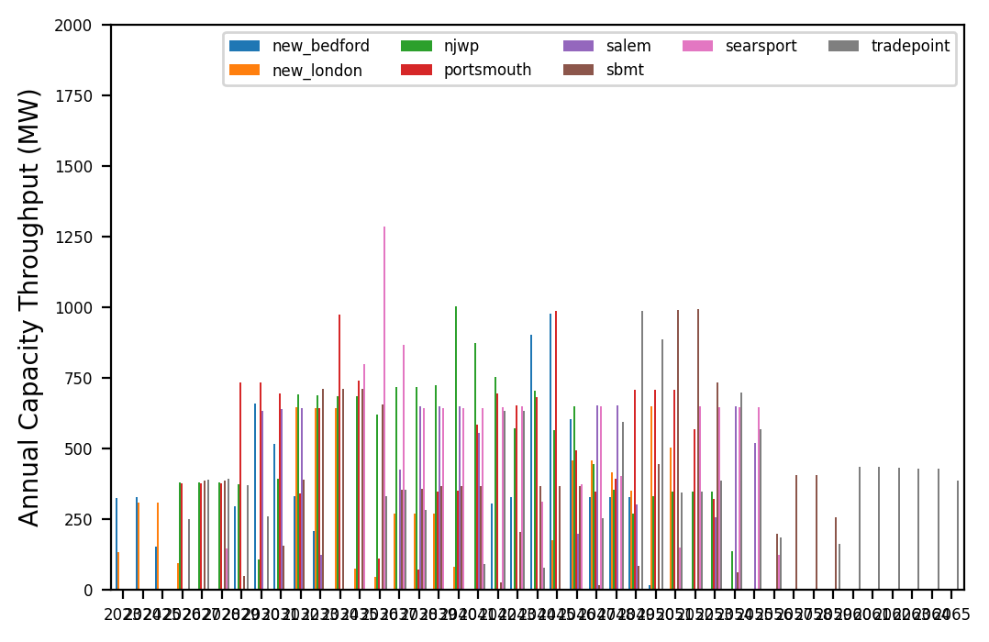
Port Throughput

Slide 17
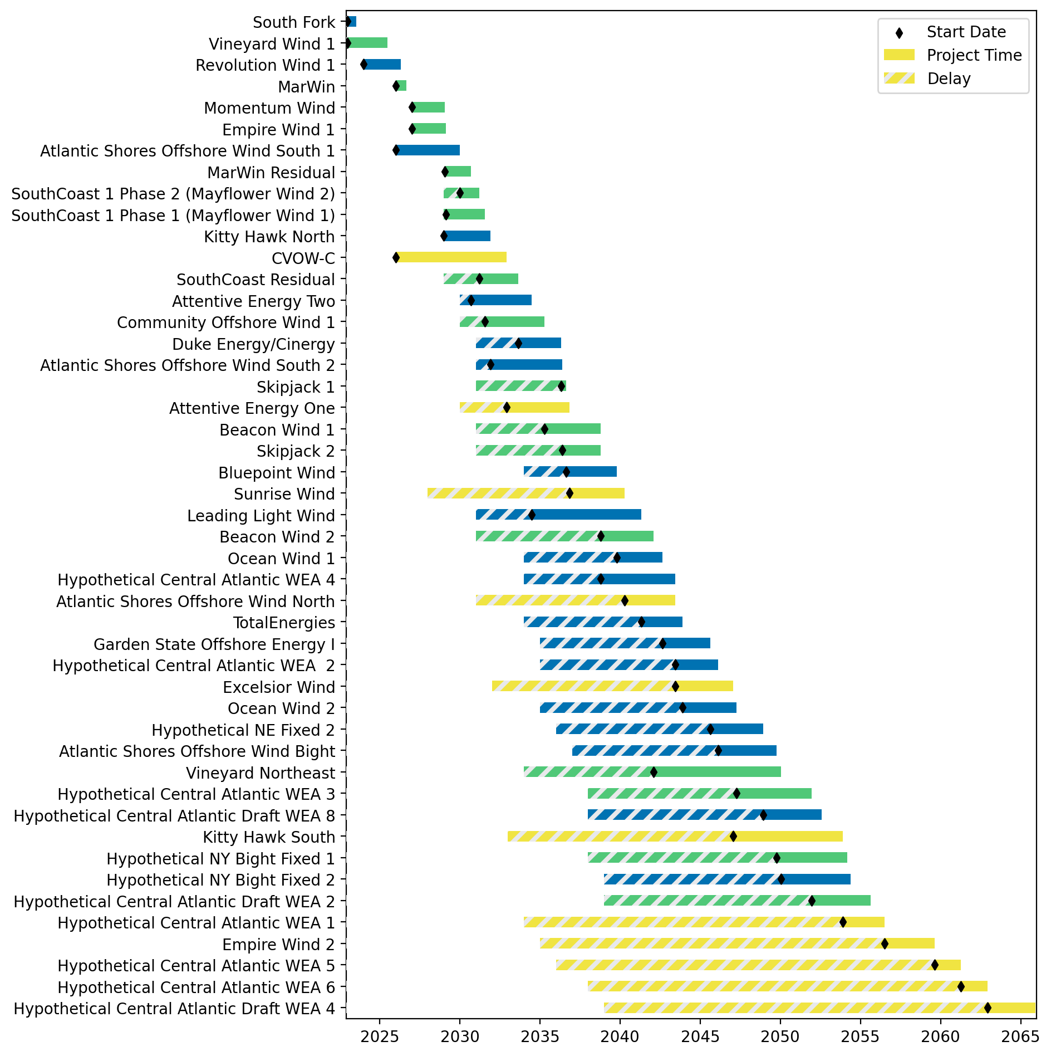
Fixed Gantt

Slide 18
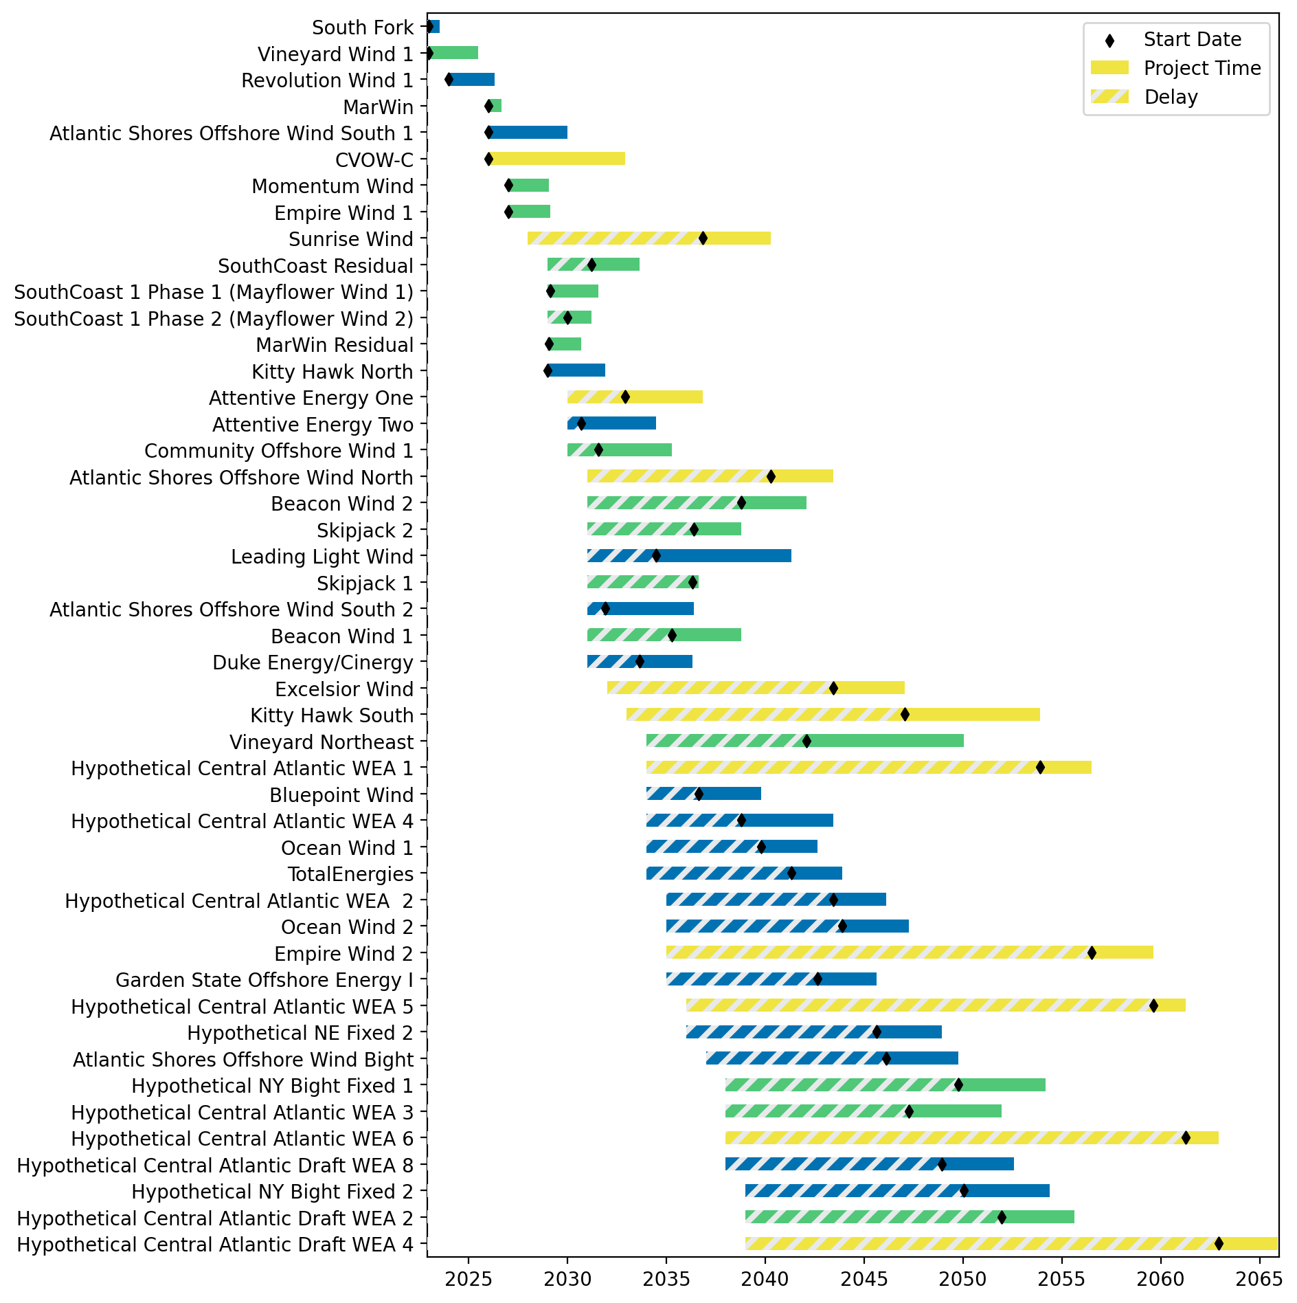
Sorted Fixed Gantt

Slide 19
natl_gaps_5foreign
1 more foreign WTIV 2025

Slide 20
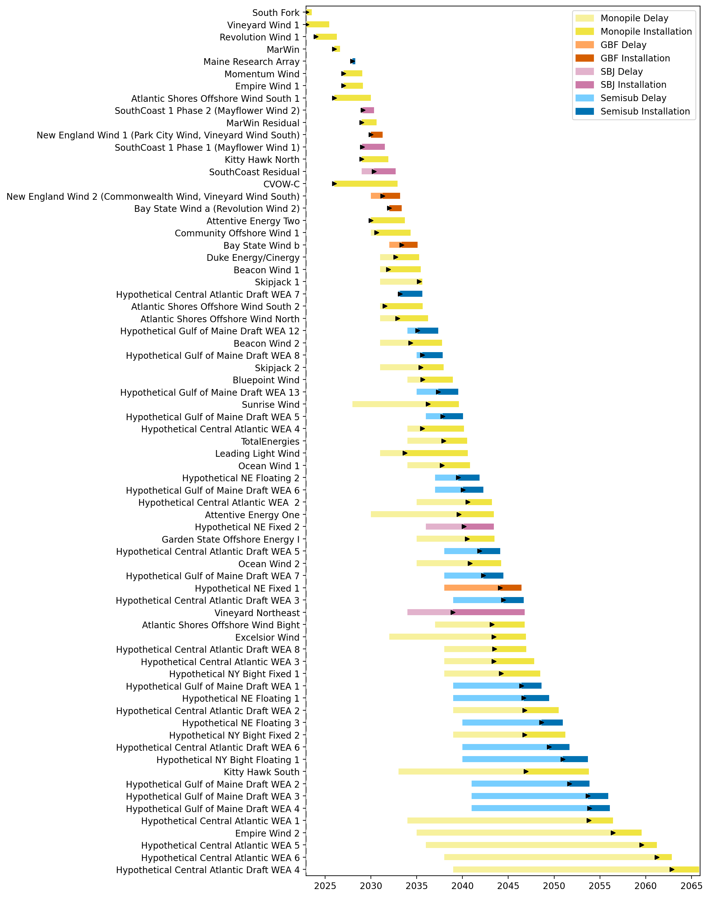
Full Gantt

Slide 21
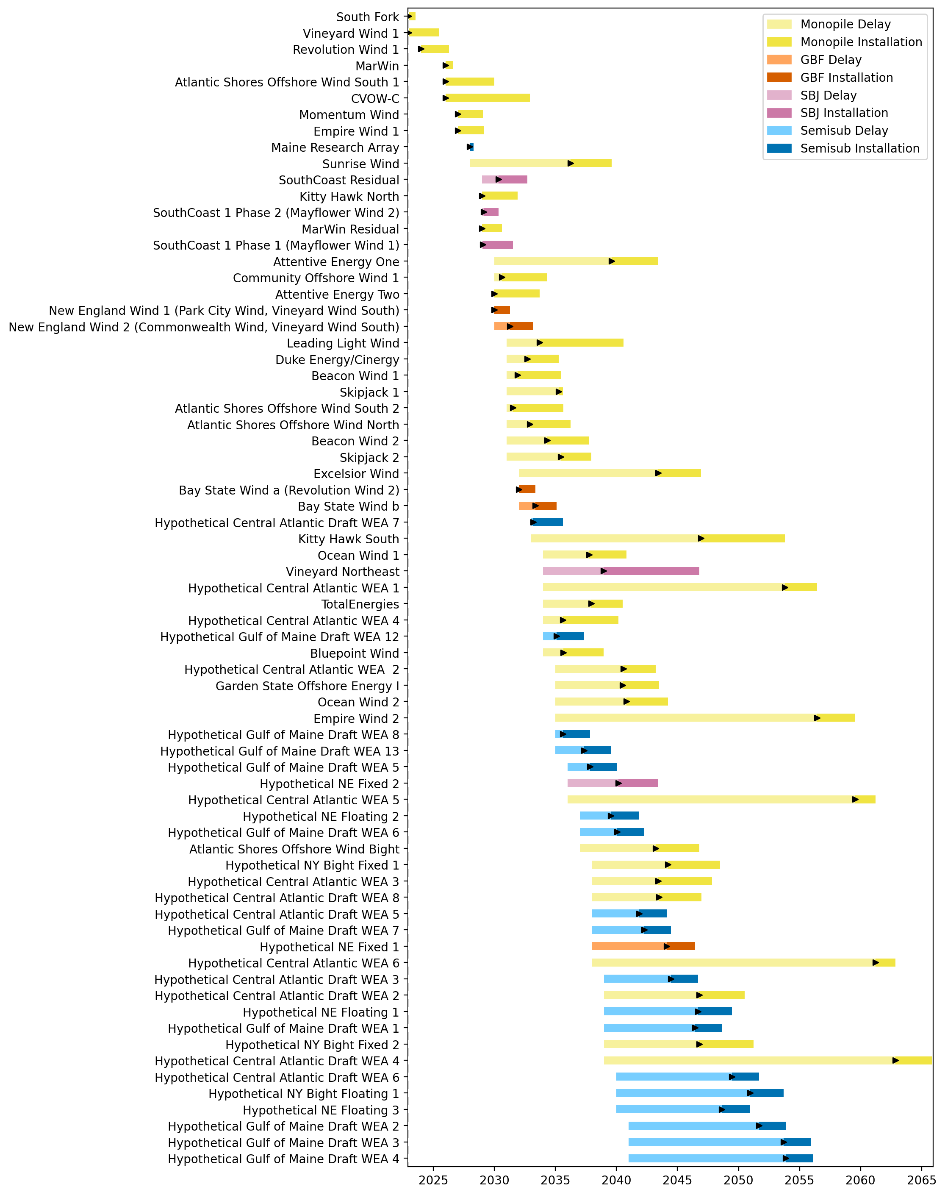
Sorted Full Gantt

Slide 22
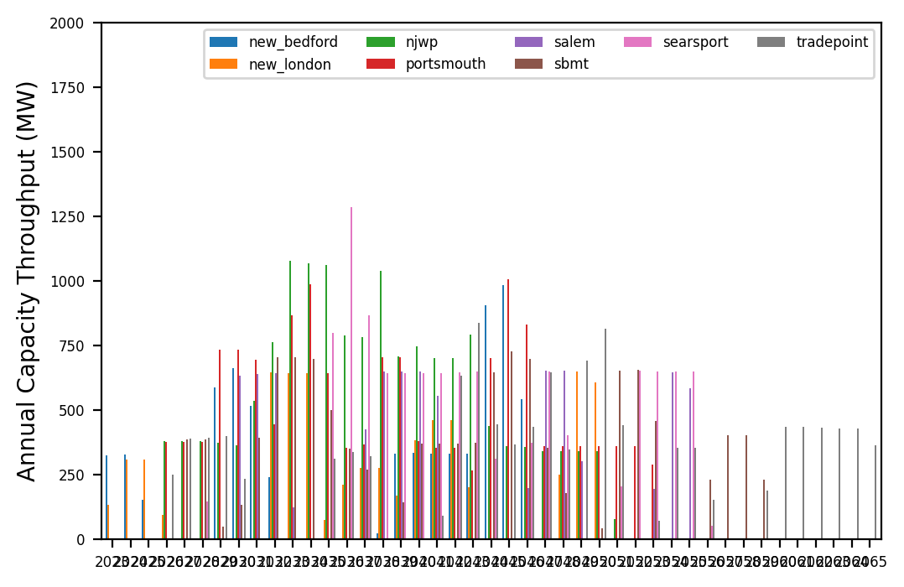
Port Throughput

Slide 23
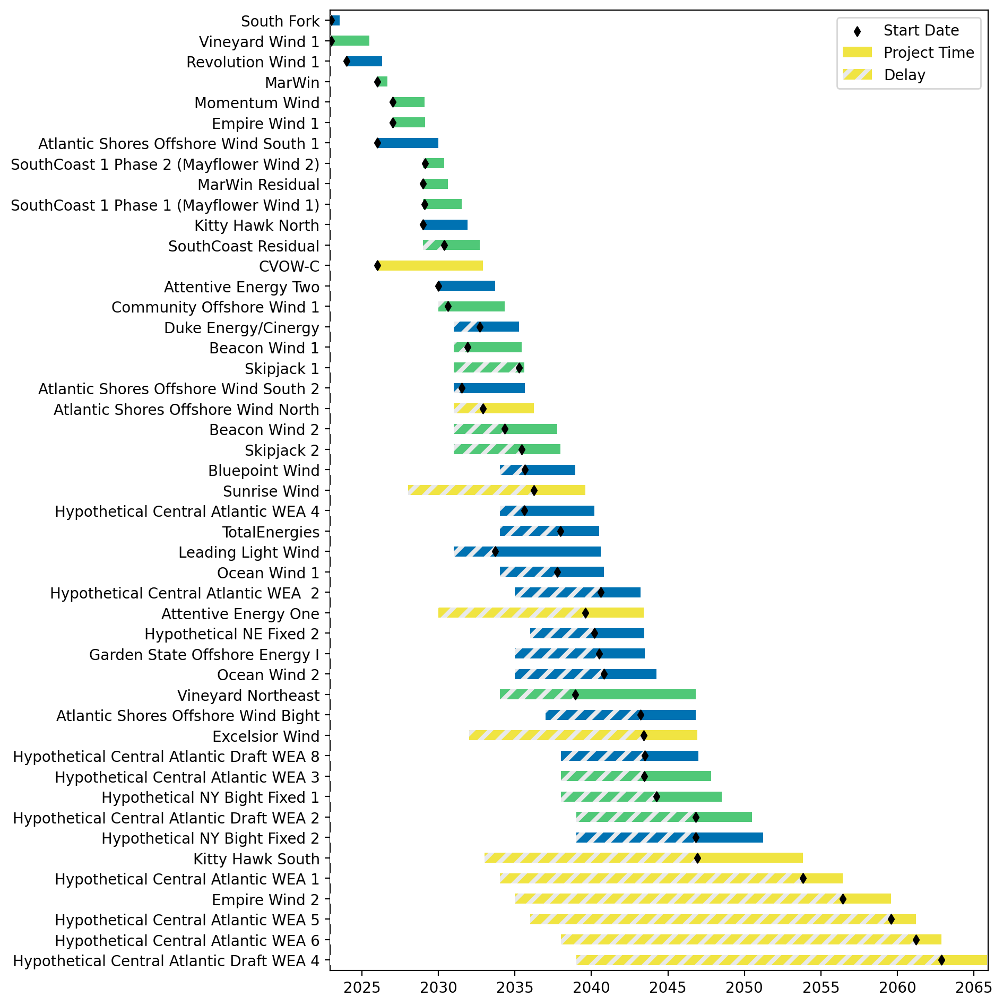
Fixed Gantt

Slide 24
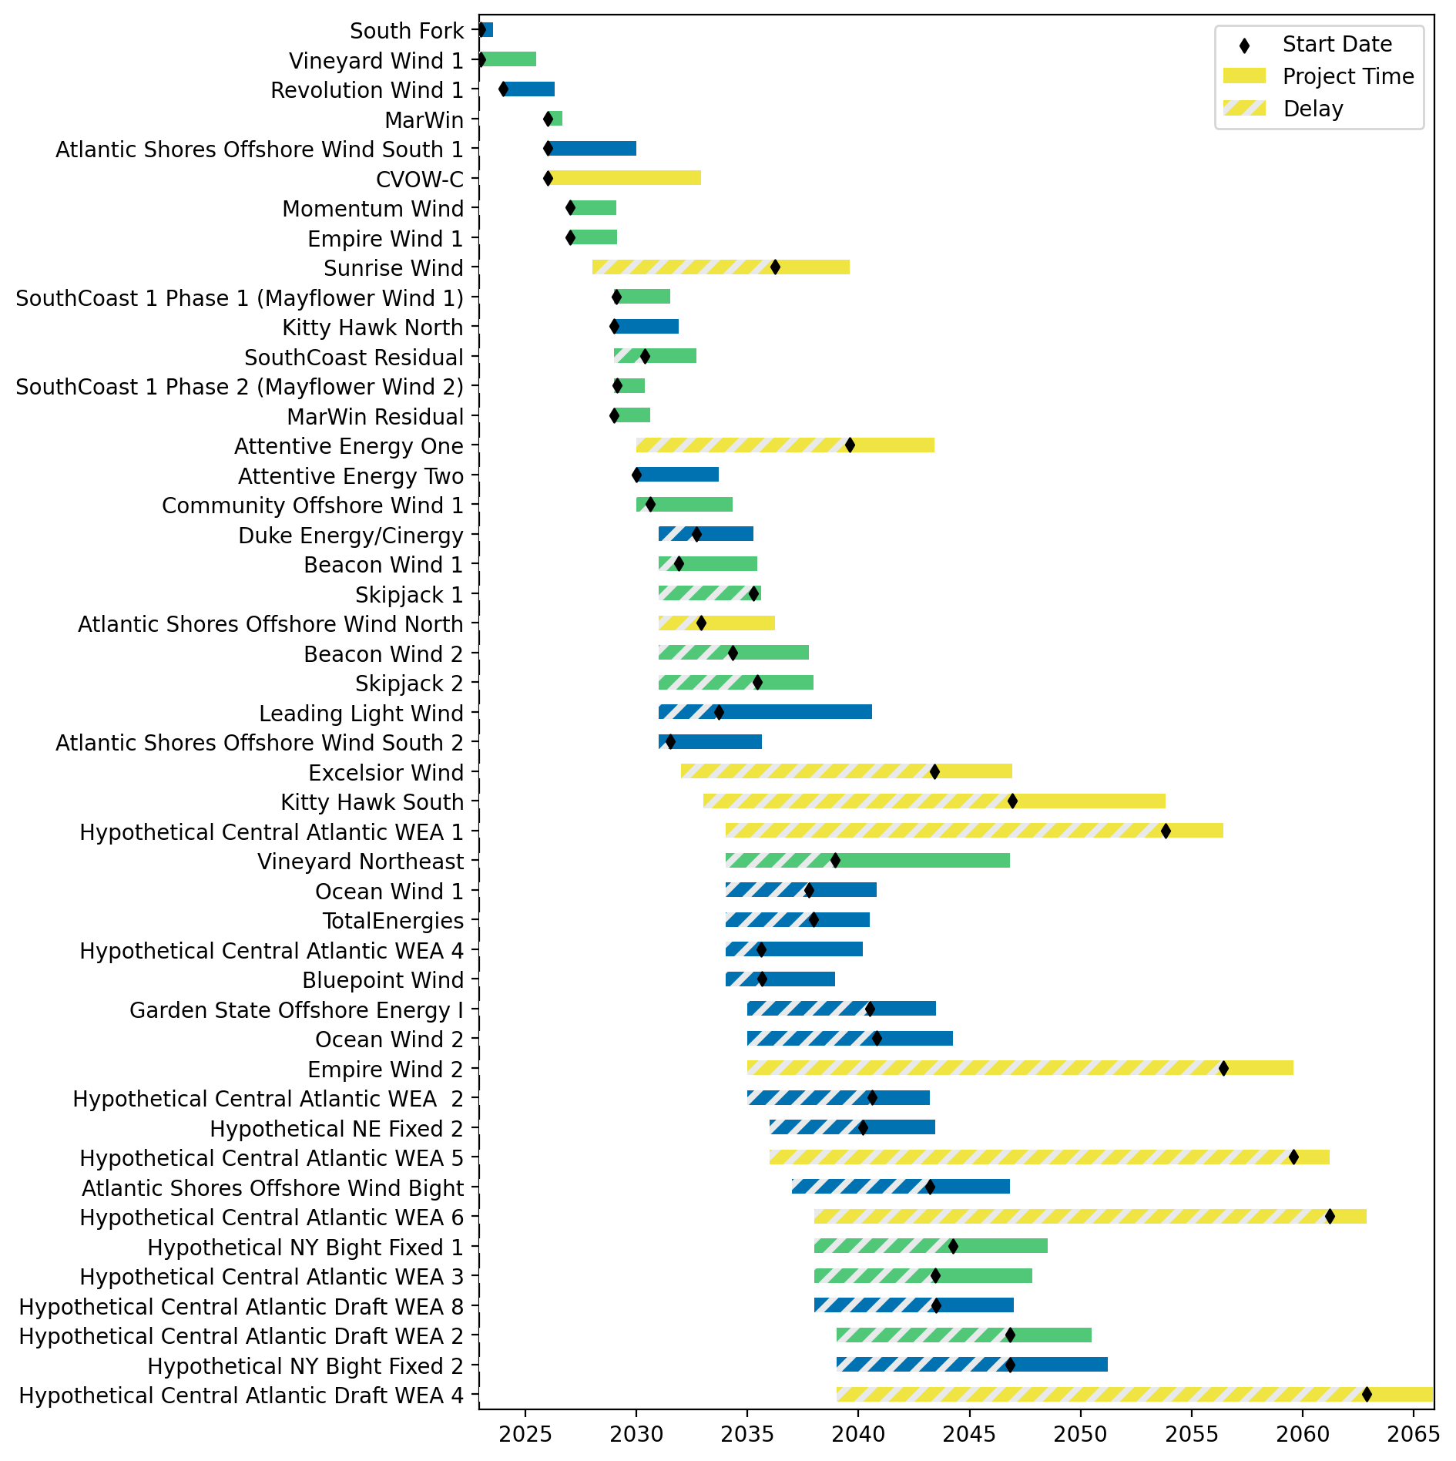
Sorted Fixed Gantt

Slide 25
natl_gaps_6foreign
1 more foreign WTIV 2025

Slide 26
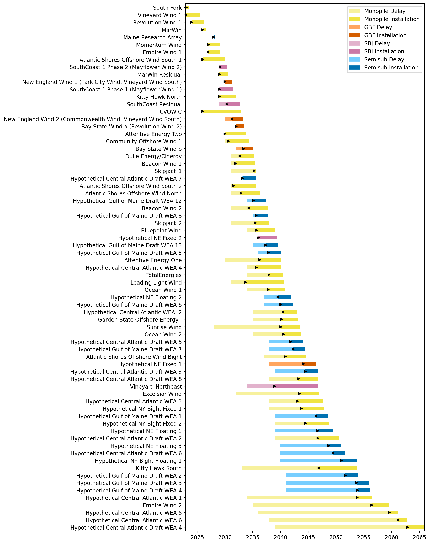
Full Gantt

Slide 27
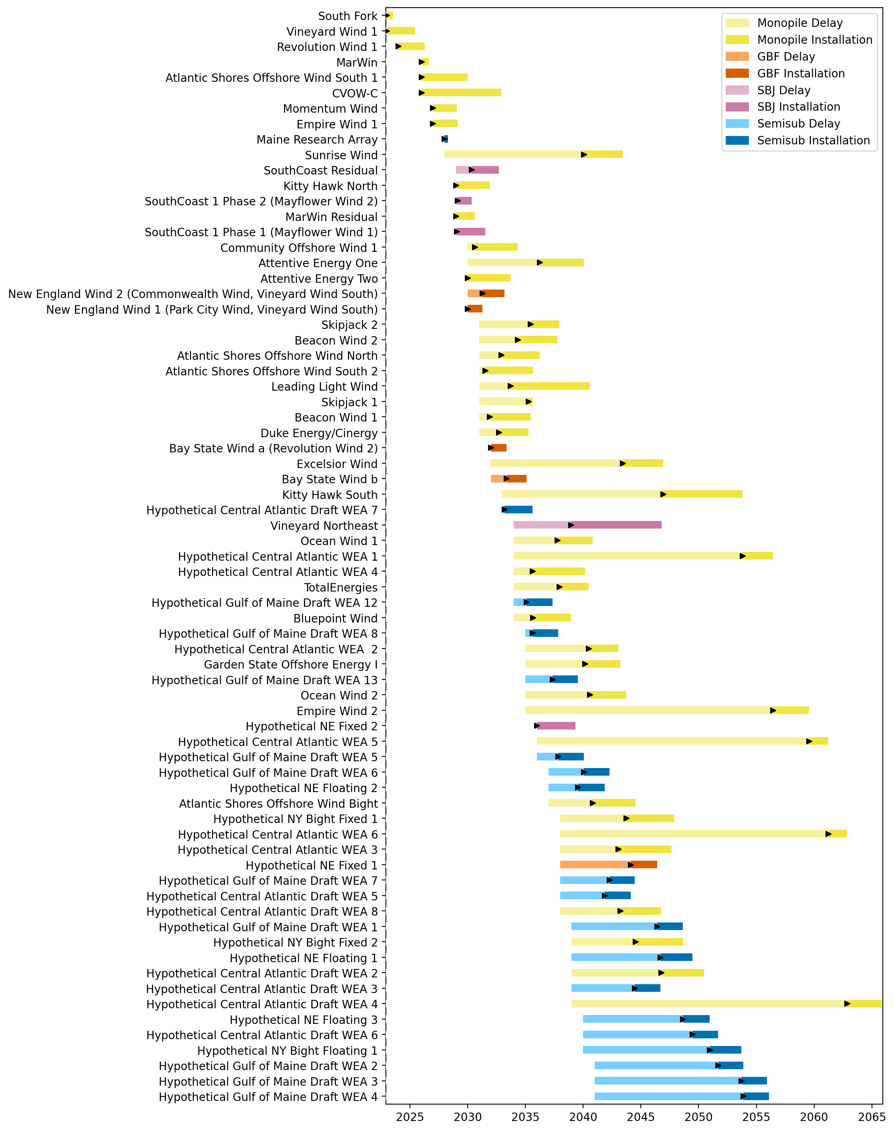
Sorted Full Gantt

Slide 28
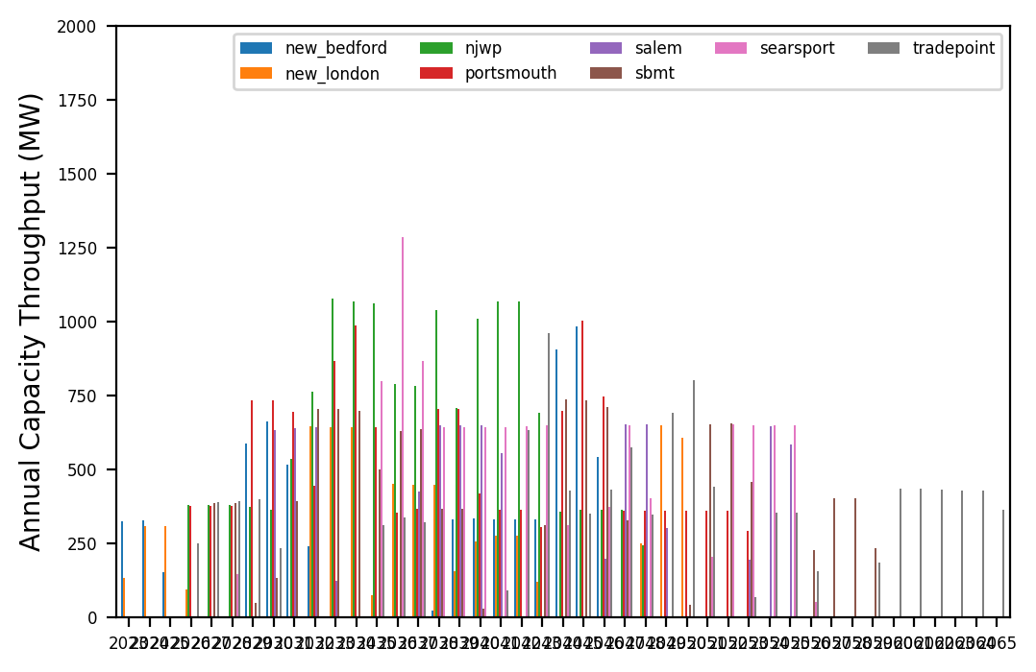
Port Throughput

Slide 29
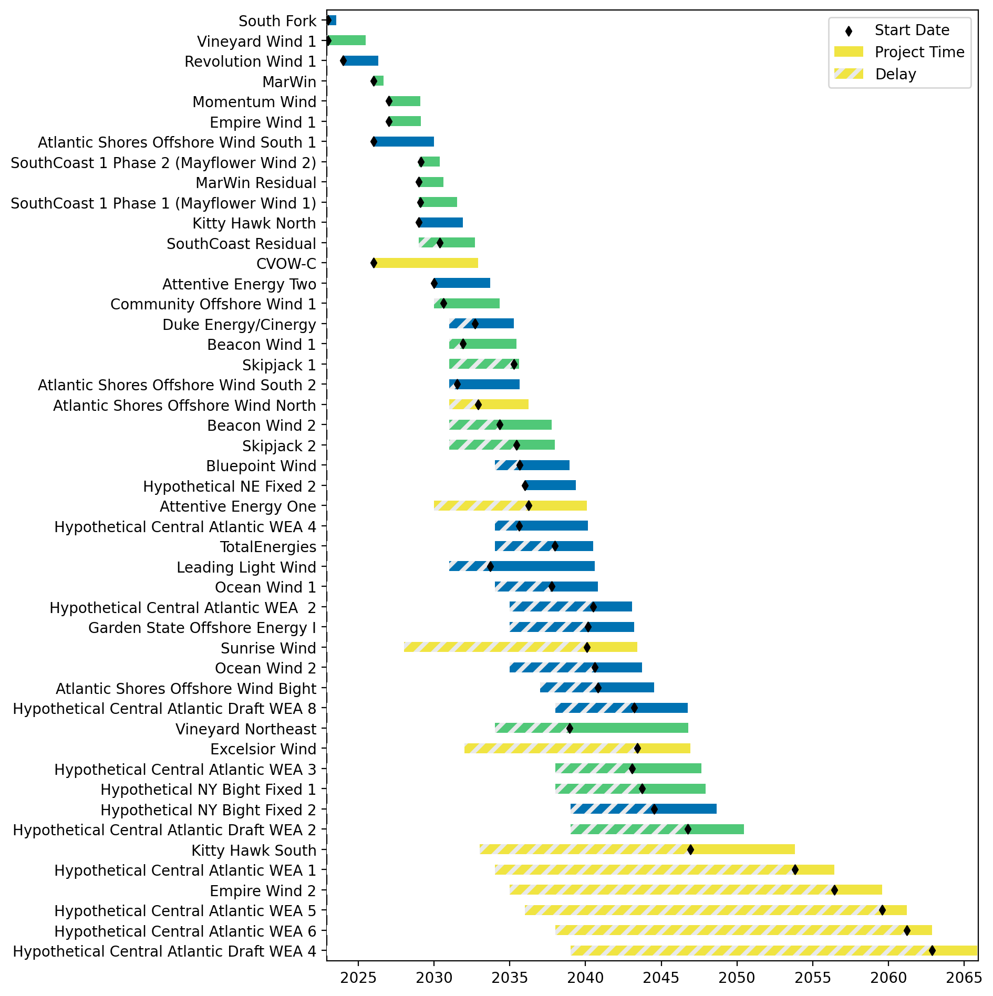
Fixed Gantt

Slide 30
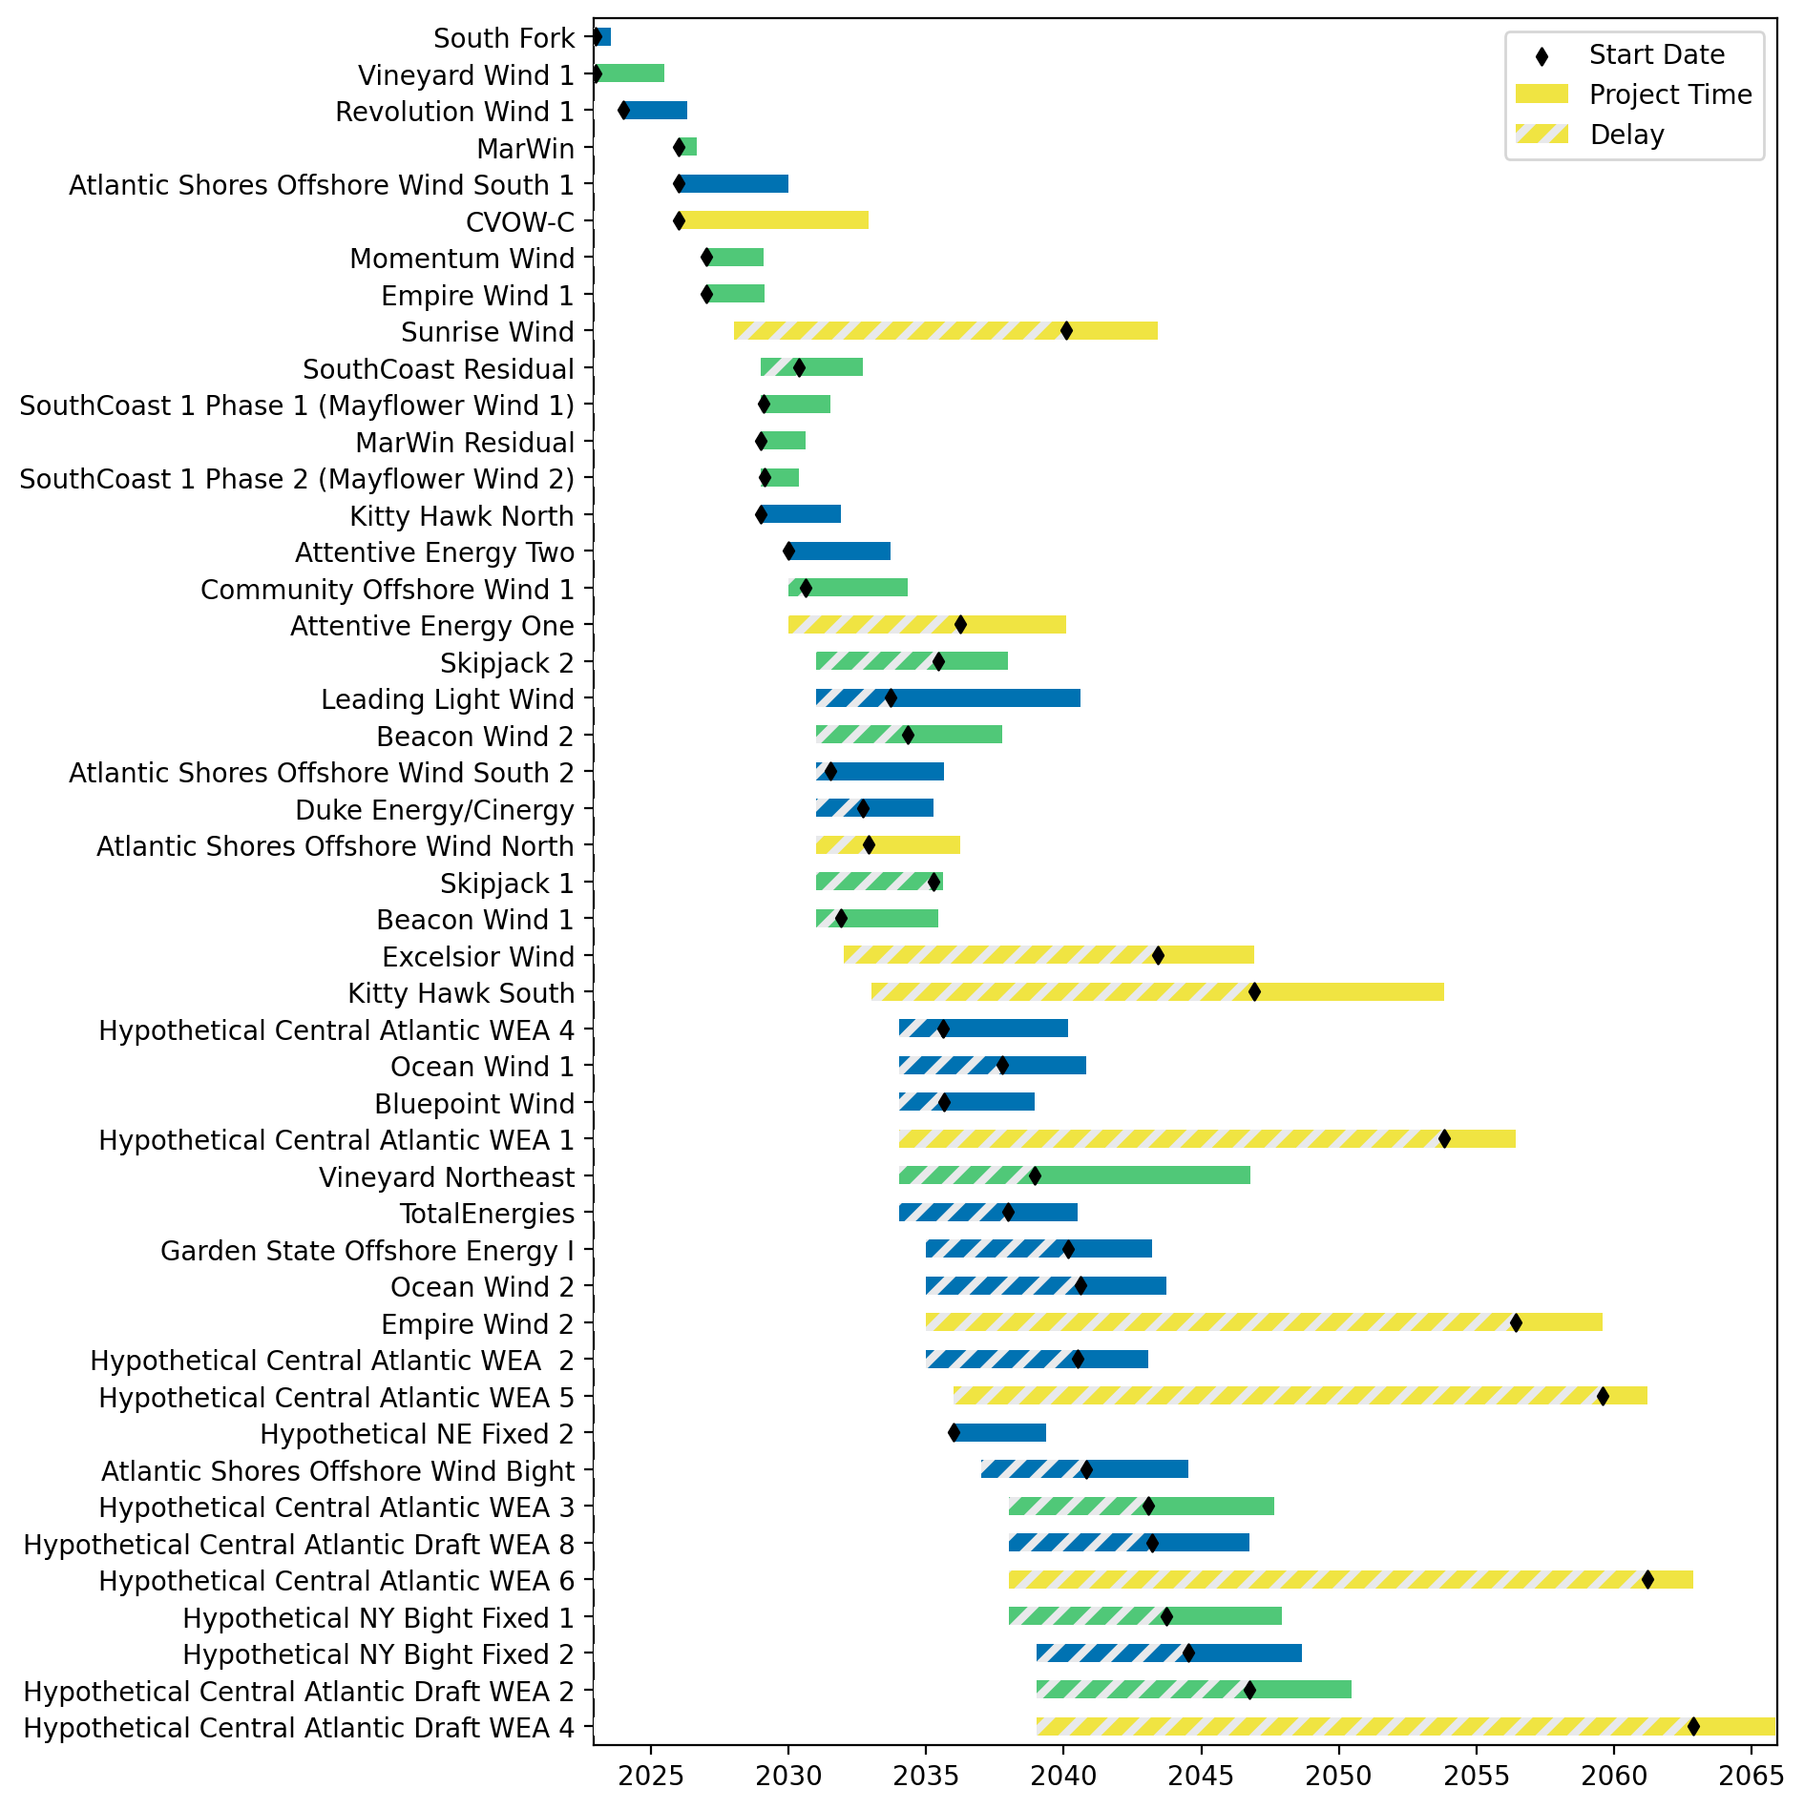
Sorted Fixed Gantt

Slide 31
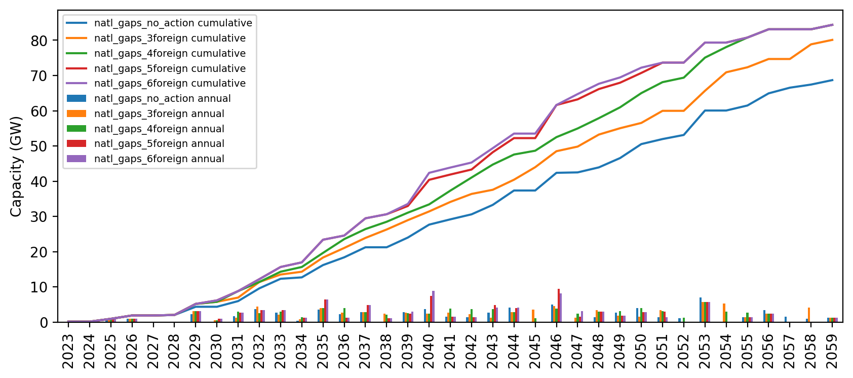
Installed Capacity

Slide 32
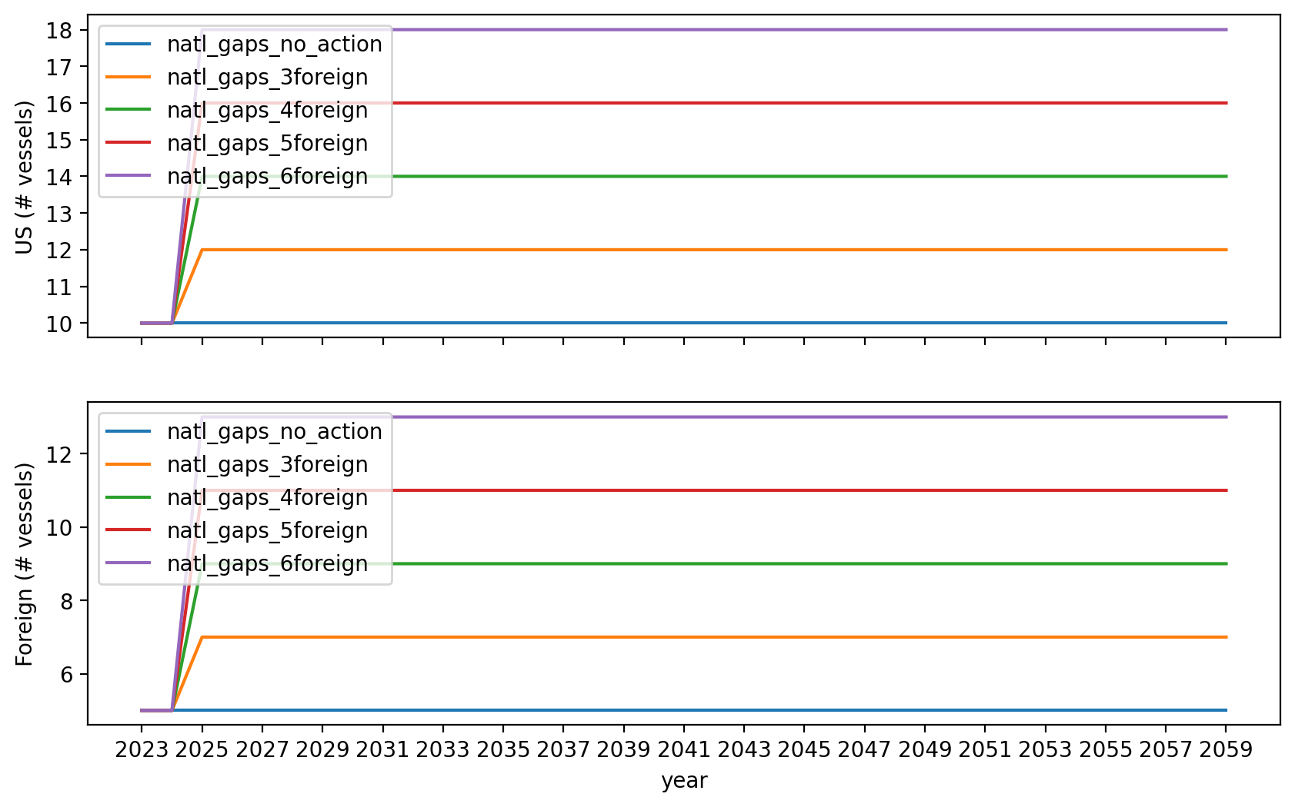
Vessel Investment

Slide 33
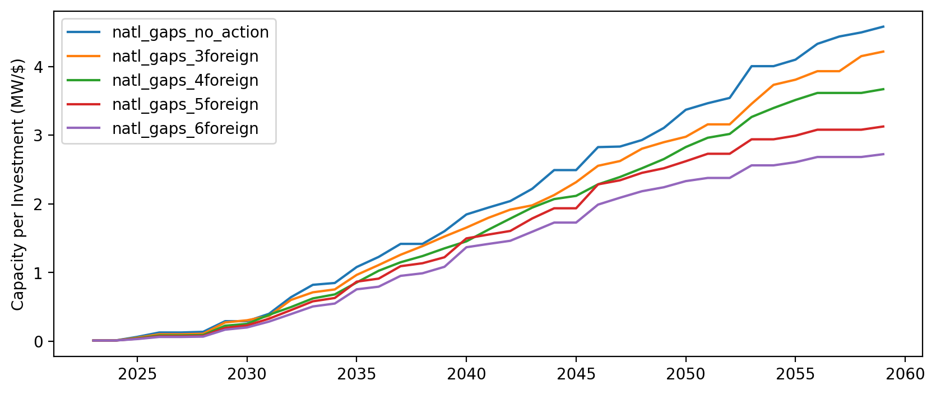
Capacity per Investment (MW/$)

